Slide 1


Representing digitai images
Matrix form
f(0,0) t(0,1)
f(1,0) i(0,1)
f(0,N-1)
f(1,N-1)
f(M—1,0) f(M—1,1)
f(M-1,N-1)
MxN
ibitms to store thae gM xeN x k
gray level = 2*

Slide 2
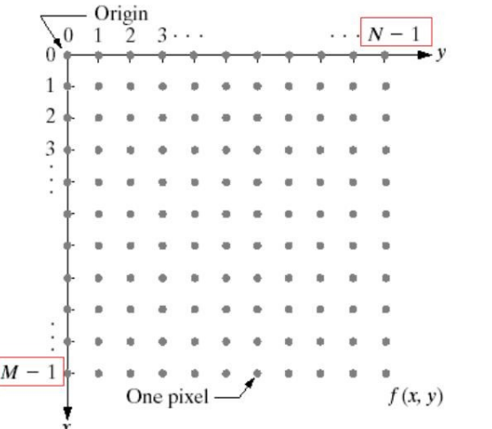
Representing digitai images

Slide 3
Representing digitai images
(cont.)
L = 2^{k} gray levels, gray scales [0,...,L-1]
The dynamic range of an image
[min(image) max(image)]
If the dynamic range of an image spans a significant portion of the gray scale -> high contrast
Otherwise, low dynamic range results in a dull, washed out gray look

Slide 4
Relationships Between Pixels

Slide 5

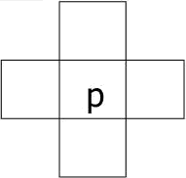
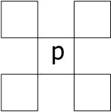
Neighbors a pixel
4-neighbors of p: N₄(p)
Diagonal neighbors: N_{D}(p)
8-neighbors 4-neighbors-rdiagonaI neighbors : N₈(p)

Slide 6

Adjacency, connectivity', regions, and boundaries
Connectivity of pixels
They are neighbors
Their gray levels satisfy a specified criterion of similarity
Concept about regions and boundaries
Adjacency
4-adjacency: p and q with intensity from V and q is in N4fp
8-adjacency: p and q with intensity from V
and q is in N_{8fp}

Slide 7

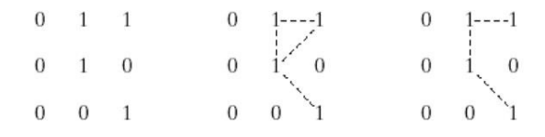

Connectivit:y and adjacency
(cont.)
m-adjacency(mixed adjacency): p and q having intensity from V and
q is in N,(p), or
q is in N_{o e}) and N,(p) nN₄(q) has no pixels whose values are from V

Slide 8


Path
A path from p: (x,y) to q sequence of pixels:
: (s,t) is a
(x,y), ^{(x}c.ve).^{(x}c.y ).
, , (x_{c} .ve_{).(}s,t)
consecutive pixels are adjacency
Length n
It's a k-path if it is 4-, and m-
adjacency

Slide 9


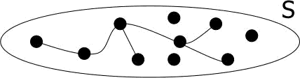
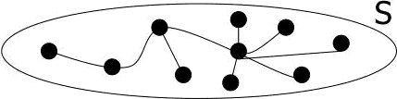
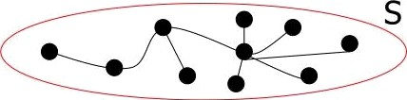
Growth of definitions
adjacency e e
path
connected component
connected
set (region)
boundary

Slide 10

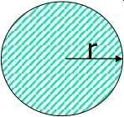
Distance measure
p: (x,y), q: (s,t)
Euclidean distance
D_{e}(p,q)=[(x-s)²+(y-t)²]^{1/2}
D₄ distance
› D (p,q)=lx-s|+|y-t|
D₈ distance
Dg(p,q)=max(|x-s|,|y-t|
2
2 1 2
2101 2
2 12
2

Slide 11
Aspect ratio
In image processing, aspect ratio refers to the proportional relationship between the width and height of an image.
It is an important parameter that affects the visual appearance and suitability of an image for different applications, such as printing, display, and analysis.
To calculate the aspect ratio of an image using OpenCV, we use method cv2.imread() function to read the image and shape attribute of an image array to obtain its dimension.

Slide 12
import cv2 # Load the image
img = cv2.imread('image.jpg')
# Get the dimensions of the image
height, width, channels = img.shape
#Calculate the aspect ratio
aspect_ratio = width / height
# Display the aspect ratio
print('Aspect ratio:', aspect_ratio)

Slide 13
Importance of image manipulation and enhancement
1. Improving image quality: to improve the quality of an image by adjusting factors such as brightness, contrast, and color balance.
2. Removing unwanted elements: It can help to improve the composition of an image and make it more visually appealing.
3. Highlighting specific features: It help to highlight specific features in an image, such as the details in a landscape or the texture of a product.
4. Creating a consistent visual identity: It help to create a consistent visual identity across a company's marketing materials or social media channels.
5. Meeting specific requirements: resolution or color profile needed for printing or online use.

Slide 14
Definition and importance of removing noise
Removing noise is the process of reducing or eliminating unwanted or irrelevant information from an image.
Noise is any random variation in an image that is not part of the underlying structure or signal, and can be caused by factors such as low light conditions, camera sensor limitations, or interference in data transmission.
Removing noise is important in image processing because it can improve the clarity and quality of the image, making it easier to analyze and interpret.

Slide 15
common techniques for removing noise include:
1. Gaussian filtering: Gaussian filtering is a type of low-pass filtering that can be used to remove high-frequency noise from an image. It works by convolving the image with a Gaussian kernel that reduces the contribution of high-frequency components.
cv2.GaussianBlur() function from the OpenCV library to apply a Gaussian filter to an image.
The function takes the input image and the standard deviation of the Gaussian kernel as parameters.
filtered = cv2.GaussianBlur(img, (5, 5), 0)

Slide 16
2. Median filtering: Median filtering is a non-linear filtering method that can be used to remove salt-and-pepper noise from an image. It works by replacing each pixel in the image with the median value of the neighboring pixels.
cv2.medianBlur() function from the OpenCV library to apply a median filter to an image. The function takes the input image and the size of the median filter as parameters.
filtered = cv2.medianBlur(img, 5)

Slide 17
3. Wavelet denoising: Wavelet denoising is a technique that uses a wavelet transform to decompose an image into multiple frequency bands, and then removes noise from each band separately. It can be used to remove both high-frequency noise and low-frequency noise from an image.
pywt library to perform wavelet denoising. The pywt.wavedec2() function can be used to perform the wavelet decomposition, and the
pywt.waverec2() function can be used to reconstruct the image after denoising.

Slide 18
4. Deep learning-based denoising: Deep learning-based denoising is a more recent technique that uses deep neural networks. It involves training a neural network on a large dataset of noisy and clean images, and then using the network to remove noise from new images
TensorFlow or PyTorch to implement deep learning-based denoising.
model = tf.keras.models.load_model ('denoising_model.h5')
denoised = model.predict(img)

